Slide 1
CSE 110: Programming Language I
Matin Saad Abdullah
mabdullah@bracuniversity.net
UB 1222

Slide 2

Introduction to programming

Slide 3
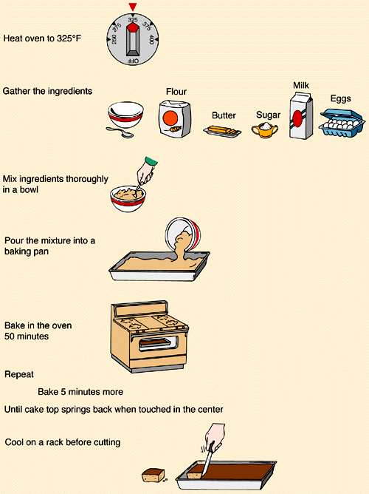
What is a program?
How to cook?
The algorithm
Are you a programmer?

Slide 4
Class task
Ask the user for two numbers and show the user the summation of the numbers.

Slide 5
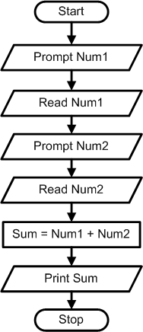

Slide 6
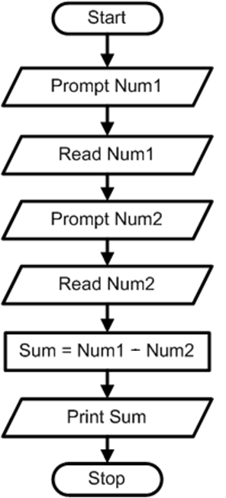
For input 5, 7,
Output?
12 ?
2 ?
-2 ?
Error as sum and “-” sign does not match

Slide 7
Sequential
Program Statements
With sequential program statements, you execute one statement after another (like steps in a list)
  After step X is completed, step X+1 will be performed, until the last statement has been executed.
Every step in the list will be performed.
Each step in the list will be performed once and only once.

Slide 8
Flow Control Design Tool: Flowcharts
Flowchart - a graphical way of writing algorithms
  Rectangle is used for calculations
  Parallelogram is used for input and output
  Circle is used as connector/junction
  Diamond is used as decision
  Symbols are connected by arrows to represent the order of the operations

Slide 9
Sequential Algorithm Example
Real World Problem:
  Calculate two children's allowances, based upon 75 cents per year old.

Slide 10
Sequential Algorithm Example
Real World Problem:
  Calculate two children's allowances, based upon 75 cents per year old.
Known Values
  Rate = 75 cents per year
Inputs
  Ages of children
Calculations
  Allowance = Age x Rate
Outputs
  Allowances for each child

Slide 11
